Slide 1
Introduction to Perl
By: Team 5
Christopher Kosel, Hadia Majed, and David Wan

Slide 2

Unix compared to Perl

Slide 3
Unix compared to Perl
Unix:
Some tasks can only be done using bash commands
Unix shell scripts are better at calling other command processes than perl
Bash scripts for tasks are mostly known as job control scripts
For bash, use to run a command by typing; run some command
Perl:
Perl is an interpreted language. It doesn’t need to be compiled.
Faster as it doesn’t require a compiler
More powerful and versatile than shell script programming
In Perl, use to run command by typing; system(“run some command”);

Slide 4
Unix and Perl Similarities
Perl contains some features from SED, AWK, and SH commands
Perl uses # to specify a comment line like in SED and AWK
Pattern-matching code is the same in both programs
Both are portable across the Unix operating systems
Perl is capable of editing text similarly to how SED edits text
\U Force all following characters to uppercase until \E is encountered
print ("\Upper case\n");
echo "upper case" | sed 's/./\U&\E/g'
Perl can run scripts like the SH command can

Slide 5
Unix and Perl Differences
AWK does not require the programer to construct looping structures to be specifically defined, the opposite of which occurs in Perl
AWK uses fewer lines of code to resolve pattern-matching extractions than Perl
Perl allows developers to make their own style and not going by a list of programming rules unlike Unix where you use the programming rules
Every variable in Perl is must be followed by a symbol as to what object is stored; other than in Unix where you have to use parentheses
Recognize names without symbols as function calls; ex: $label = join(‘ ‘ ,@parts);

Slide 6
Overview of Perl

Slide 7


Basics of Perl
Practical Extraction and Report Language (Perl)
Released as a in 1987 and created by Larry Wall
Perl takes the best features from other languages, such as C, AWK, SED, SH, and BASIC, among others.
Perl has many Applications
Perl is a highly flexible for programming
Useful for database integration
Perl works with Markup Languages
Popular for making websites

Slide 8
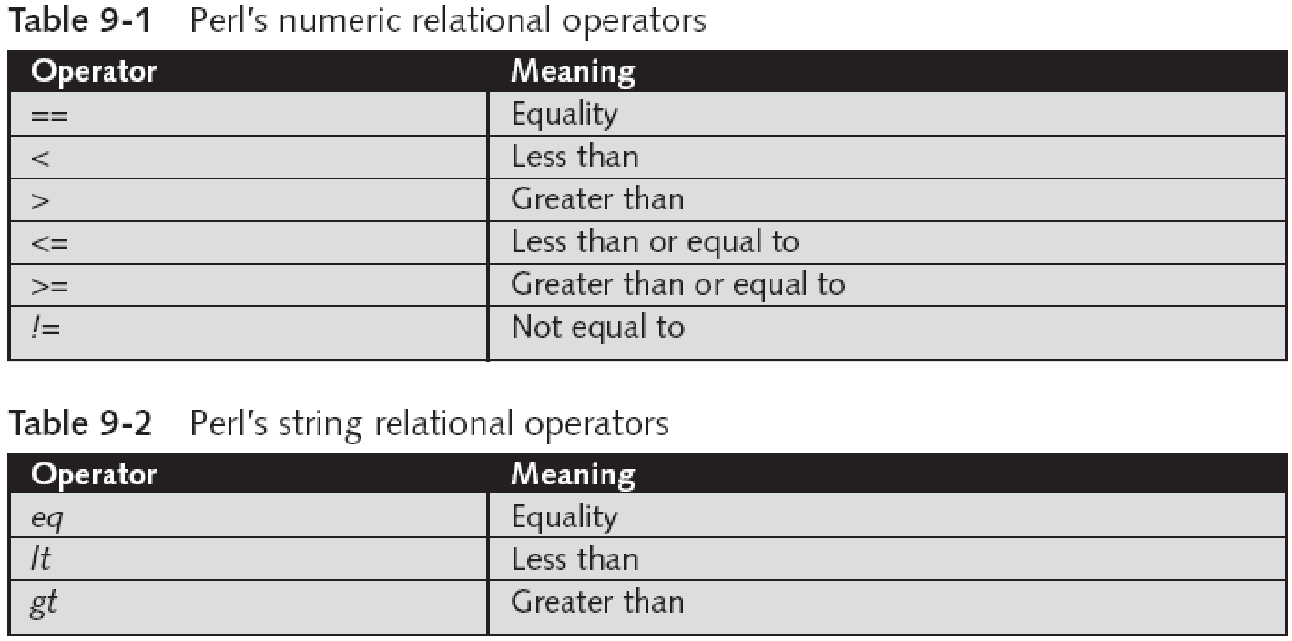
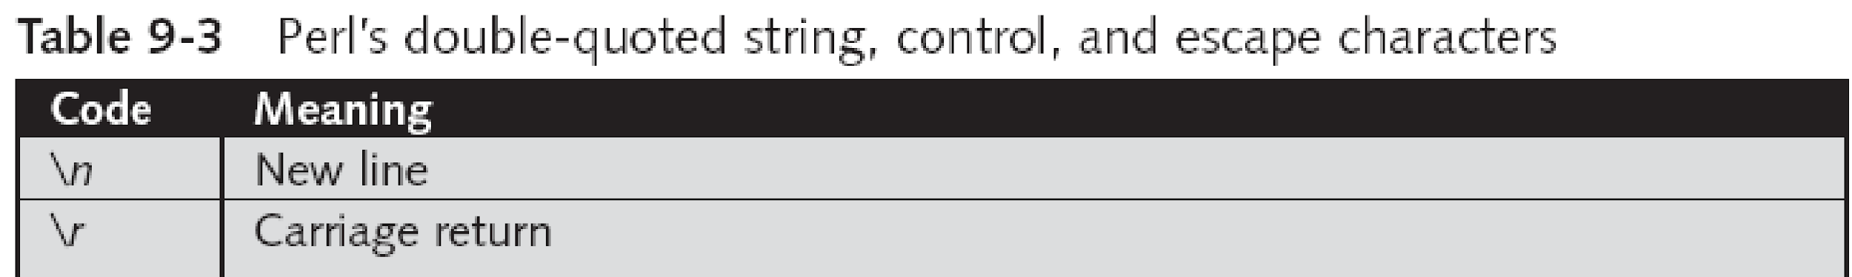
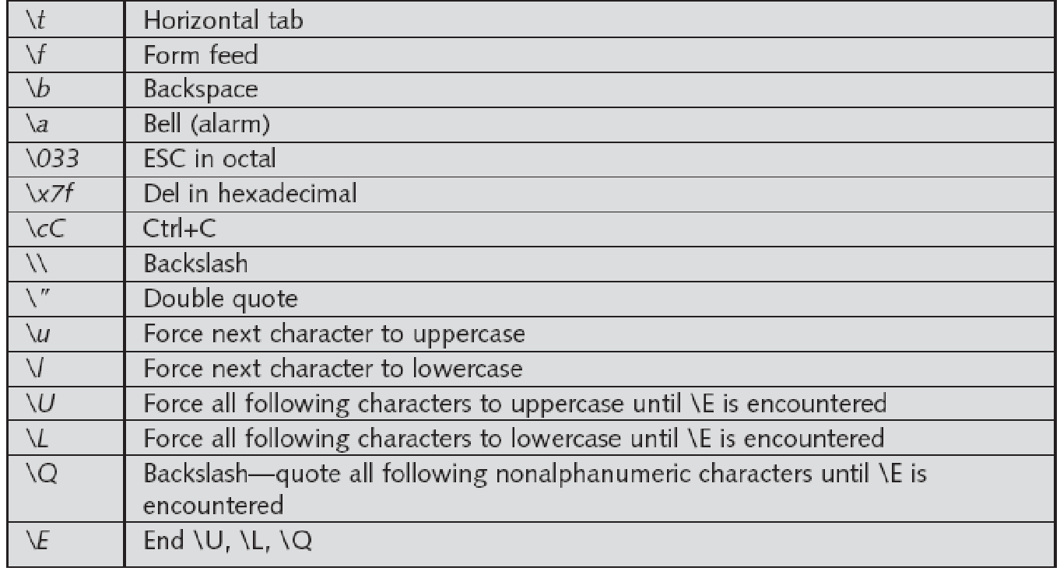
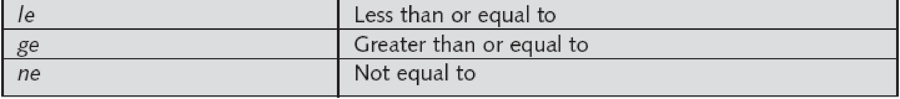
Perl Programming
Contains many features found in Unix.
Supports many features of SED, AWK, GREP, and SH.
Similar to the C programming language
C and C++
General-purpose programming that support procedural, functional, and object-oriented programming.

Slide 9
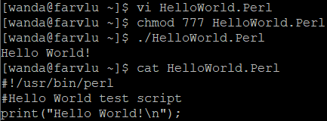
Perl Implementation
First line of a program begins with #! to give the pathway of the interpreter.
#! /usr/bin/perl
The # character marks the beginning of a comment.
Inserting code: Flexible syntax options
print ("Hello World\n");
print "Hello World\n";
In Perl, data can be represented in a variety of ways
Variables and constants, Scalars, Numbers, Strings, Arrays, and Hashes.
Perl can perform multiple tasks, such as:
Loops and Conditions
Displaying Inputs/Outputs
File Handling
Pattern Matching
Searching
Sorting

Slide 10
Perl Demo

Slide 11
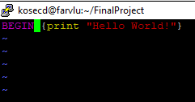
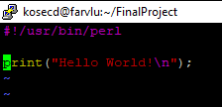
1.
Unix and AWK
VS
Perl

Slide 12

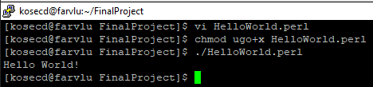
2.
Unix and AWK
VS
Perl

Slide 13
References / Resources
(Slide Notes)
Guide to Unix using Linux by Michael Palmer, Chapter 9 (page 457)
Chapter 9 Slides (On Blackboard)
https://www.tutorialspoint.com/perl/perl_introduction.htm
http://blogs.perl.org/users/buddy_burden/2012/04/perl-vs-shell-scripts.html
https://www.stat.berkeley.edu/~spector/extension/perl/notes/node6.html
https://www.ece.ucdavis.edu/~vojin/CLASSES/EEC70/W2004/UNIX-basics.pdf
https://www.geeksforgeeks.org/hello-world-program-in-perl/
https://www.computerhope.com/unix/uperl.htm

Slide 14
Vocabulary / Terms
Scalar- a simple variable that holds a number or string; ex: $x = 12; or $name =“Bob”;
Arrays- variables that store an ordered list of scalar values; ex: arr = (1, 2, 3); or arr = (1, 2, 3 “Hello”);
Hashes- variable that represents a set of value pairs; ex: my $fruit = ‘apple’; $color_of{$fruit} = ‘red’;
Filehandle- name for an I/O connection between Perl and OS; ex: STDIN, STDOUT, and STDERR (Used to open, read, write, and close the file)
Inline sort block- is a compact list of numbers; ex: @sortednumbers = sort { $a <=> $b; } @numberlist;

Slide 15
The End
Thank you for listening!

